Slide 1
Part I: System Analysis Fundamentals
Lecture Note 1
Assuming the Role of the Systems Analyst
Systems Analysis and Design
Kendall & Kendall
Sixth Edition

Slide 2
Major Topics
Basic Concepts
Describe an information system and explain its components and characteristics
Fundamentals of different kinds of Information systems
* The varied roles of system analysts
* The phases in the systems development life cycle
System maintenance and Enhancements
The Approaches to System Development Life Cycle

Slide 3
Basic Concepts
System Analysis:
System analysis and design is a complex process and is used to analyze, design and implement improvements in the functioning of businesses.
Systems analysis and design is a systematic approach to:
        Identifying problems, opportunities, and objectives.
        Analyzing the information flows in organizations. Such as
        * data input or data flow systematically
        * processing or transforming data
        * data storage and information output.
        3. Designing computerized information systems to solve a problem.
Need for systems analysis and Design

Slide 4
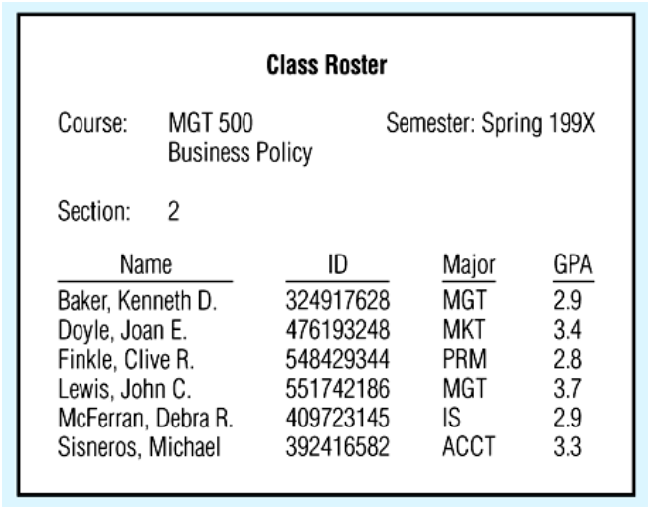
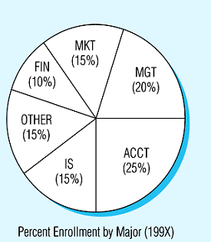
Information and Data:
The data consists of basic facts that are the system’s raw material. (Eg. hours worked, pay rate and deductions)
Information is the data that have been processed into a useful form of output. (Eg. Paycheck)
Information is a key resource. It is a critical factor in determining the success or failure of a business.
Processed data
Summarized data

Slide 5
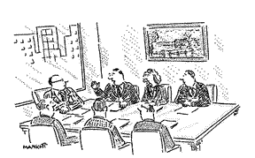
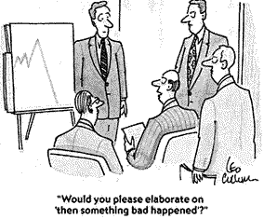
System Analyst:
System analyst is a person who can start from a complex problem, break it down logically, and identify the reasonable solutions.
The system analyst views a systems situation in terms of its scope, objectives, and the organizational framework. She/he plays many roles, balancing several at same time.
Find the problem
Analysis the problem
Solve the problem

Slide 6


Hardware and Software:
Hardware refers to the physical layer of the information. The component includes computers, networks, communications equipment, scanners, printers, digital capture devices and other technology-based infrastructure.
System software controls the hardware and software environment and includes the operation system, communications software and utility programs.
Application software consists of programs that process data to produce information needed by user. (Eg. Word processors, DBMS)
It is also designed to support specific organizational functions or processes.

Slide 7
Business Information System
Payroll system
Completing a deduction form
The payroll department enters and processes the deduction.
Paycheck, a report to the employee on the check stub, a credit to employee’s account.
Database
Data
Interface
Procedures
Information
Input
Output
Hardware
Software
Processing
An information system is the effective use of hardware, software, database, procedures, and interface to achieve specific results that support the company’s business objectives.

Slide 8
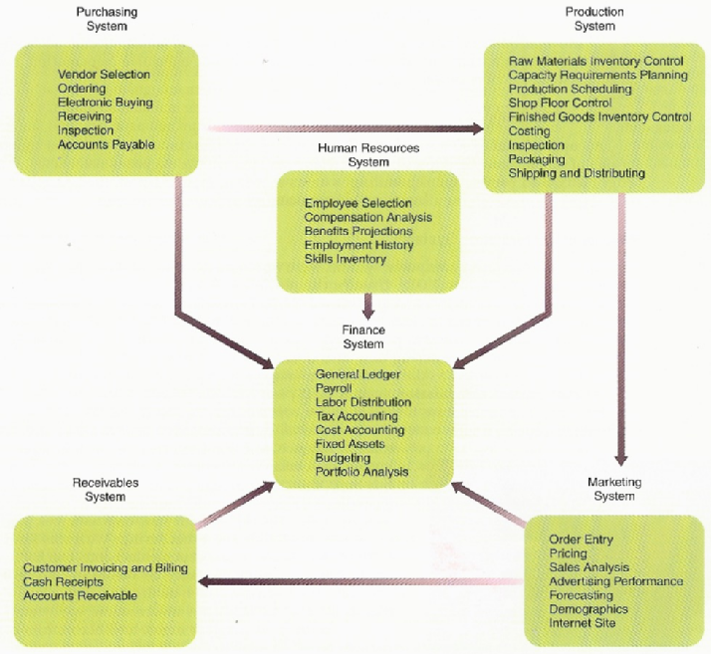
Characters:
Relationships with other system – information systems often are interdependent.
Boundaries – A boundary between two systems indicates where one system ends and the other system begins.
Specialized business needs – The typical business information systems includes many specialized information systems.
Size of company – Large and small companies in the same industry have very different information systems requirements.
Business information systems and subsystems in an industrial company. Arrows show the flow of data and information from one system to another.

Slide 9
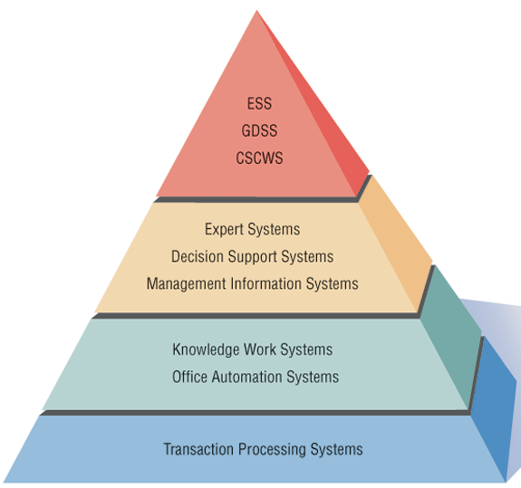
Fundamentals of different kinds of Information systems
Operational level: perform routine functions
  Transaction processing systems (TPS).
Lower Management: develop day-to-day plans & supervise operational personnel
  Office automation systems (OAS).
  Knowledge work systems (KWS).
Middle Management: develop short-range goals, plans, and tactics
  Management information systems (MIS).
  Decision support systems (DSS).
  Expert systems (ES)
Top Management: develop long-range goals, plans, and strategies
  Group decision support systems (GDSS)
  Executive support systems (EES).
  Computer-supported collaborative work systems (CSCWS).

Slide 10
Transaction Processing Systems (TPS): | Process large amounts of data for routine business transactions. Payroll system, inventory system
Office Automation Systems (OAS): | Supports data workers to transform data or manipulate data. Word processing, spreadsheets, voice mail, email and voice conferencing.
Knowledge Work Systems (KWS): | Supports professional works to create new knowledge.
Management Information Systems (MIS): | Is computerized information systems that work because of the purposeful interaction between people and computers. By requiring people, software, hardware to function in concert, management. Decision analysis, decision making.
Decision Support Systems (DSS): | It is a high level class of computerized information system. It depend on a database as a source of data to support decision maker.
Expert Systems (ES): | Captures and uses the knowledge of an expert for solving a particular problem experienced in an organization. It base on knowledge base, an inference engine connecting the user with the system by SQL and user interface.

Slide 11
Artificial Intelligence (AI): | To develop machines that behave intelligently. Two avenues of AI research are understanding nature language and analyzing the ability to reason through a problem to its logical conclusion.
Group Decision Support Systems (GDSS): | Are used in special rooms equipped , permit group members to interact with electronic support – often in form of specialized software. It is intended to bring a group together to solve a problem with the help of various supports.
Computer-Supported Collaborative Work Systems (CSCWS): | Include software support called groupware for team collaboration (合作) via networked computers.
Executive Support Systems (ESS): | To help executives organize their interactions with the external environment. Help executives to make decisions on the strategic level.

Slide 12
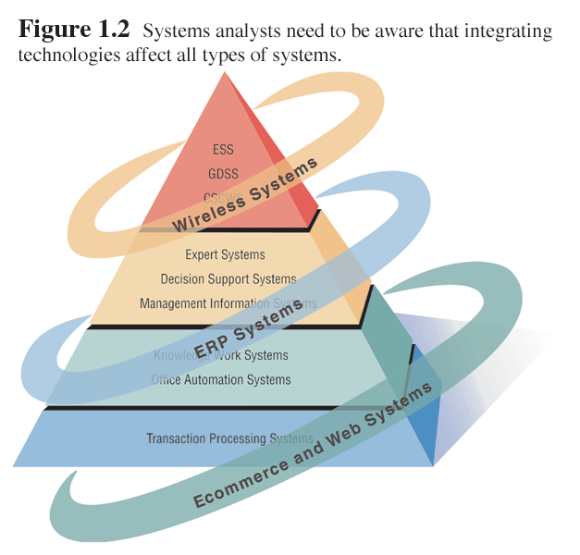
Integrating technologies for system
Ecommerce applications and web system
  Increasing awareness (了解) of the availability a service, product, industry, person or group.
  The possibility of 24-hour access for users.
  Standardizing the design of the interface.
  Creating a system that can extend globally.
Enterprise resource planning systems
  ERP are designed to perform the integration of many information systems existing on different management levels and within different functions.
System for wireless and handheld devices
  Analysts are being called to design a plethora (過多的) of new systems and applications, including many for wireless devices and handheld computers such as the popular Palm computer series and other personal digital assistants (PDAs).
Open source software

Slide 13
The varied roles of System Analysts
The system analyst is responsible for a wide range of activities such as :
  Selecting hardware and software packages
  Designing computer files
  Training users
  Recommending improvements to business procedures
  Building a new Web site.
  Plans project , Develop schedules, Estimate costs.

Slide 14
Systems analysts act as:
  Consultants (顧問) to businesses
    The systems analyst may be hired to address information systems issues within a business.
    Advantage: Outside consultants can bring with them fresh perspective (觀點).
    Disadvantage: the true organizational culture can never be known to an outsider.
  Supporting experts within a business
    The analyst draws on professional expertise concerning computer hardware and software and their uses in the business.
    He serves as a resource for those who are managing a systems project.
    He supports business decision making.
  Change agents
      Acting as an a agent of change.
      Develops a plan for change.
      Works with others in facilitating that change.

Slide 15
Required Skills
To be a successful systems analyst, analytical, technical, management, communication skills are necessary.
    Problem solving abilities -- Problem solver.
    Communication skills -- Be a communicator capable of relating meaningfully to other people. Get information requirements from users.
    Computer experience -- Can systematically handle the situation, through application of tools, techniques and experience. Need enough computer experience to program. Understand the capabilities of computers.
    Self-discipline and self-motivation -- is able to manage and coordinate innumerable project resources, including other people.
    Project management capabilities -- Communicate what is needed to programmers. Need to posses strong personal and professional ethics.

Slide 16
Systems Development Life Cycle
The Systems Development Life Cycle (SDLC) is a systematic approach to solving business problems.
SDLC is the overall process of developing information systems through a multi step process from investigation of initial requirements through analysis, design, implementation and maintenance.
It is divided into seven phases.
The SDLC is a complete set of steps. The steps are not purely linear: steps overlap in time.
Each phase has unique activities.

Slide 17
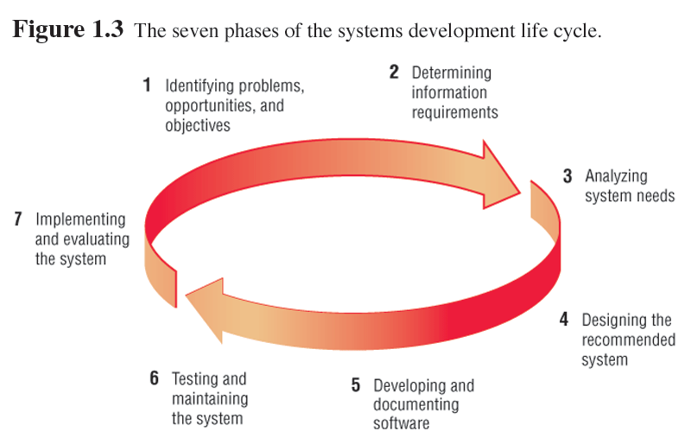

Slide 18
Phase 1:
Identifying Problems, Opportunities and Objectives.
This stage is Critical to the success of the rest of the project.
Recognising Problems:
    what is occurring in a business.
    Find out problems.
Opportunities confronting the business:
    Opportunities are situations that SA believes can be improved.
Determining business Objectives:
    Discover what the business is trying to do (objectives).
    See if some aspect of information systems applications can help the business reach its objectives.

Slide 19
  Activities in this phase consist of :
    Interviewing user management
    Summarizing the knowledge obtained
    Estimating the scope of the project
    Documenting the results.
      Output: feasibility report (a problem definition + summary of the objectives)
      Management then makes a decision on whether to proceed with the proposed project.
The people involved:
User , System Analyst, and system manager.

Slide 20
Phase 2:
Determining Information Requirements
Understanding what information users need to perform their jobs.
  Interview management, operations personnel.
  Gather systems/operating documents.
  Use questionnaires.
  Observe the system and personnel involved.
SA needs to know the details of current system functions:
      Who (the people who are involved),
      What (the business activity),
      Where (the environment in which the work takes place),
      How (how the current procedures are performed)

Slide 21
Finally, SA should understand how the business functions and have complete information on the people, goals, data, and procedures involved.
Personnel involved:
  Analyst.
  User management.
  User operations workers.
  Systems management.

Slide 22
Phase 3:
Analyzing System Needs
Needs:
  Document procedural logic for Data Flow Diagram (DFD) processes.
  Complete the Data Dictionary.
  Make semi-structured decisions.
  Prepare and present the System Proposal.
  Recommend the optimal solution to management.
Chart the input, processes, and output of the business’s functions.
Lists all of the data items used in the system.
Summarizes what has been found,
Provides cost/benefit analysis of alternatives
Make recommendations on what should be done.

Slide 23
Phase 4:
Designing the Recommended System
SA uses the information collected to accomplish the logical design.
  Design the user interface.
    Design input. (Design good form and screen)
    Design output. (onscreen and printed)
  Design system controls & backup procedures. (protect the system and the data)
  Design files and/or database. (Well-organized database is the basic for IS.)
  Produce program specifications packet.
    input & output layouts
    file specifications, processing details
    decision trees / tables
    DFD, system flowchart, the names & functions of any prewritten code routines.
  Produce decision trees or tables.
Personnel involved:
  Analyst. System designer. User management. User operations workers. Systems management.

Slide 24
Phase 5:
Developing and Documenting Software
Works with programmers to
  Design computer programs using structure charts, Nassi-Schneiderman charts, and pseudocode.
  Write computer programs.
Works with users to
  Document software with help files, procedure manuals, and Web sites with Frequently Asked Questions.
SA develop documentation for software
  Procedure manuals, online help
Programmers design, code, and remove errors from computer programs.
Personnel involved:
  Analyst. System designer. Programmers. Systems manager.

Slide 25
Phase 6:
Testing and Maintaining the System
First with sample data and then with actual data from the current system.
  Test and debug computer programs.
  Test the computer system.
Maintenance & documentation is carried out throughout the life of the information system.
Personnel involved:
  Analyst.
  System designer.
  Programmers.
  Systems management.

Slide 26
Phase 7:
Implementing and Evaluating the System
Train users to handle the system.
Plan a smooth conversion from the old to the new system
  Files from old to new formats
  Build a database
  Install equipment
  Bring the new system into production
  Install system
Evaluation to see whether the intended users are indeed using the system.
Personnel involved:
  Analyst. System designer. Programmers. User management. User operations workers. Systems management.

Slide 27
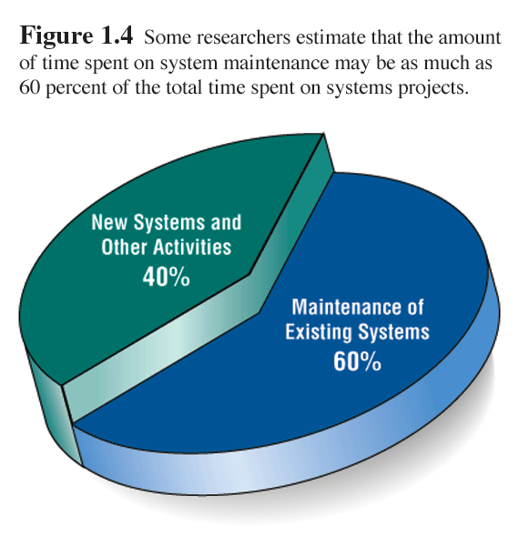
System Maintenance
After the system is installed, it must be maintained:
System maintenance is:
  Correct software errors.
  Enhancing existing software.
Time spent on maintenance typically ranges from 48-60 percent of total time.

Slide 28
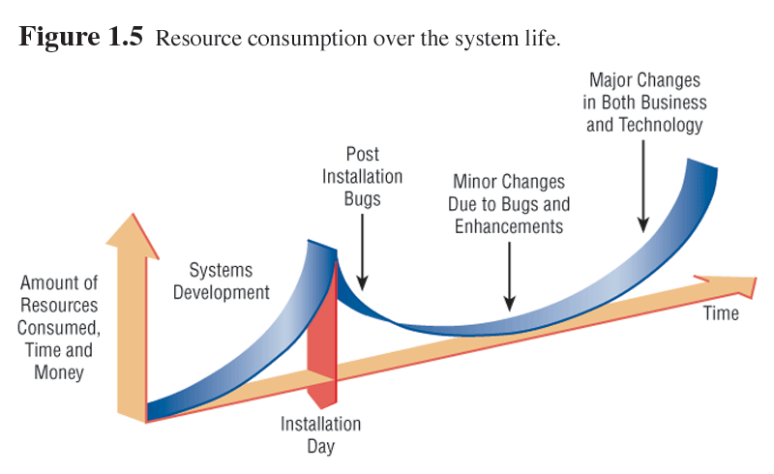
System Enhancements
Systems are enhanced for the following reasons:
  Adding additional features to the system.
  Business and governmental requirements change over time.
  Technology, hardware, and software are rapidly changing.

Slide 29
The Approaches to
System Development Life Cycle
Object-oriented Analysis and Design:
consists of the objects, inheritance and object class in using Unified Modeling Language UML, which are widely adopted as the standard set of object modeling techniques used by many systems and developers.
  Object-oriented (O-O) analysis and design is used to build object-oriented programs.
  O-O programming examines the objects of a system.
  Objects are grouped into classes for optimal reuse and maintainability.

Slide 30
Computer-Aided Software Engineering (CASE):
is the application of tools, methods, and disciplines to produce the maintain an automatic solution to a real-world problem.
  CASE tools are automated, microcomputer-based software packages for systems analysis and design.
  Four reasons for using CASE tools are:
      * To increase analyst productivity.
    * Facilitate communication among analysts and users.
    * Providing continuity between life cycle phases.
    * To assess the impact of maintenance.

Slide 31
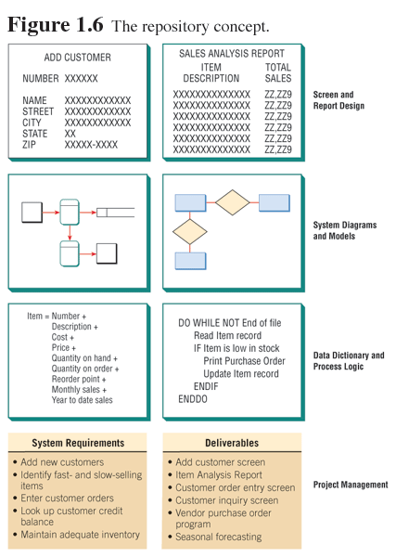
Upper CASE Tools
Upper CASE tools: allows the analyst to create and modify the system design. All the information about project is stored in CASE repository.

Slide 32
Lower CASE Tools
Lower CASE tools: are used to generate computer source code.
  Time to develop new systems decreases.
  The time to maintain generated code is less than to maintain traditional systems.
  Computer programs may be generated in more than one language.
  CASE design may be purchased from third-party vendors and tailored to organizational needs.
  Generated code is free from program coding errors.

Slide 33
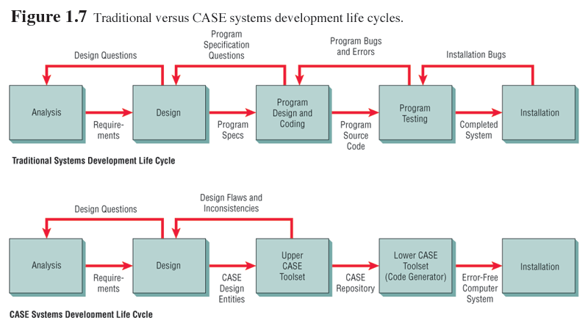

Slide 34
Questions
What personal qualities are helpful to the systems analyst?
    Problem solving abilities, Communication skills, Computer experience, Self-discipline and self-motivation, Project management capabilities
List briefly define the seven phase of the systems development life cycle.
      A. Identifying problems, opportunities, and objectives--recognizing problems and opportunities confronting the business and determining business objectives.
      B. Determining information requirements--understanding what information users need to perform their jobs.
      C. Analyzing system needs--structured analysis of information needs and decision making.
      D. Designing the recommended system--logical design of the information system.
      E. Developing and documenting software--structured development of software and documentation.
      F. Testing and maintaining the system--testing and revising the system.
      Implementing and evaluating the system--training users and reviewing system.
List three roles that the systems analyst is called upon to play? Consultant, Supporting Expert, Change Agent

